Slide 1
SGS Systems & Ops Hiring Dashboard
Systems & Infrastructure Role

Slide 2
Executive Summary
Total Candidates: 39
Avg Days to Close: 27.9 days
Key Insights:
• LinkedIn = Better for volume & Top Choice candidates
• Slack = Much higher conversion & faster closes
• Trial Tasks & Interviews were the strongest validators

Slide 3
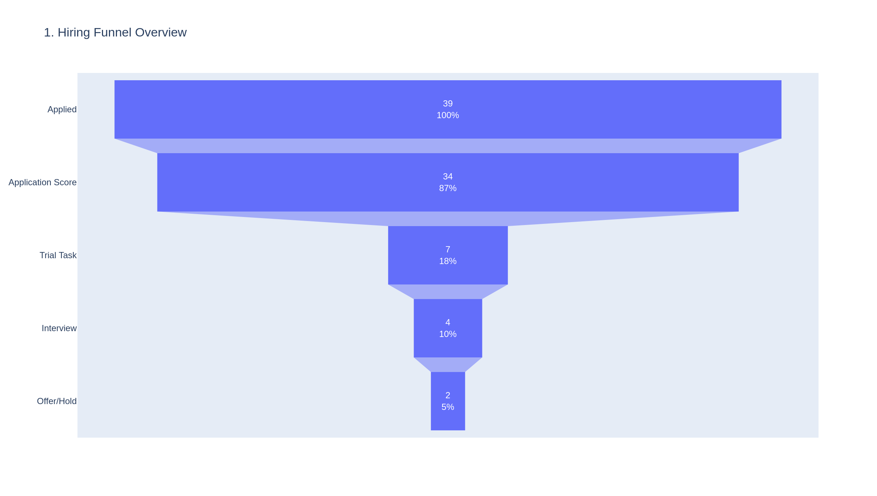
1. Hiring Funnel Overview

Slide 4
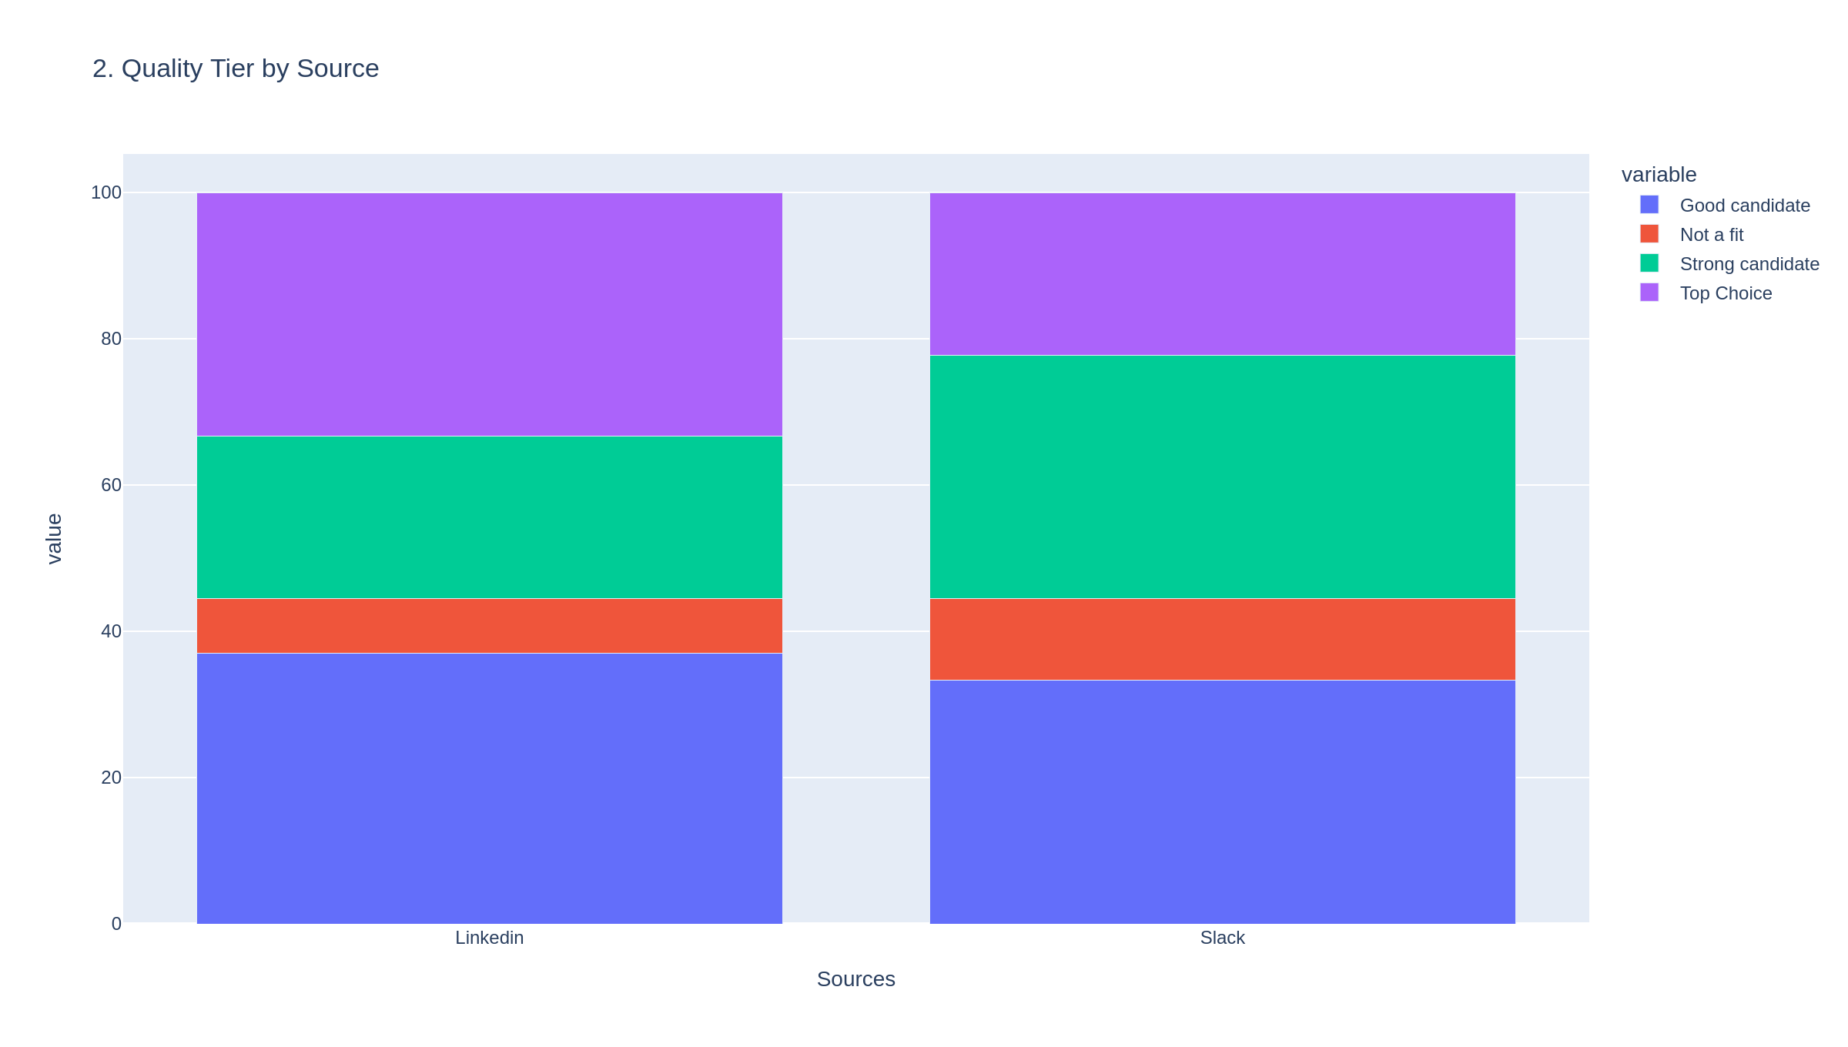
2. Quality Tier by Source

Slide 5
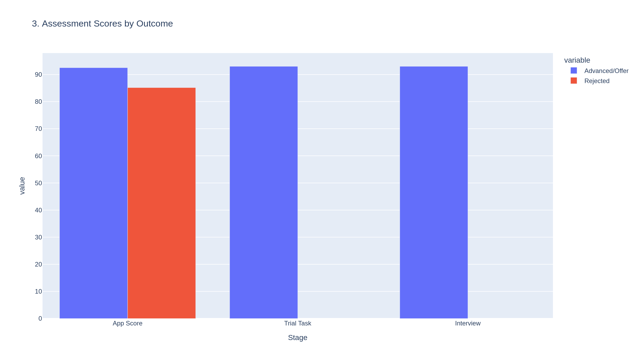
3. Assessment Scores by Outcome

Slide 6
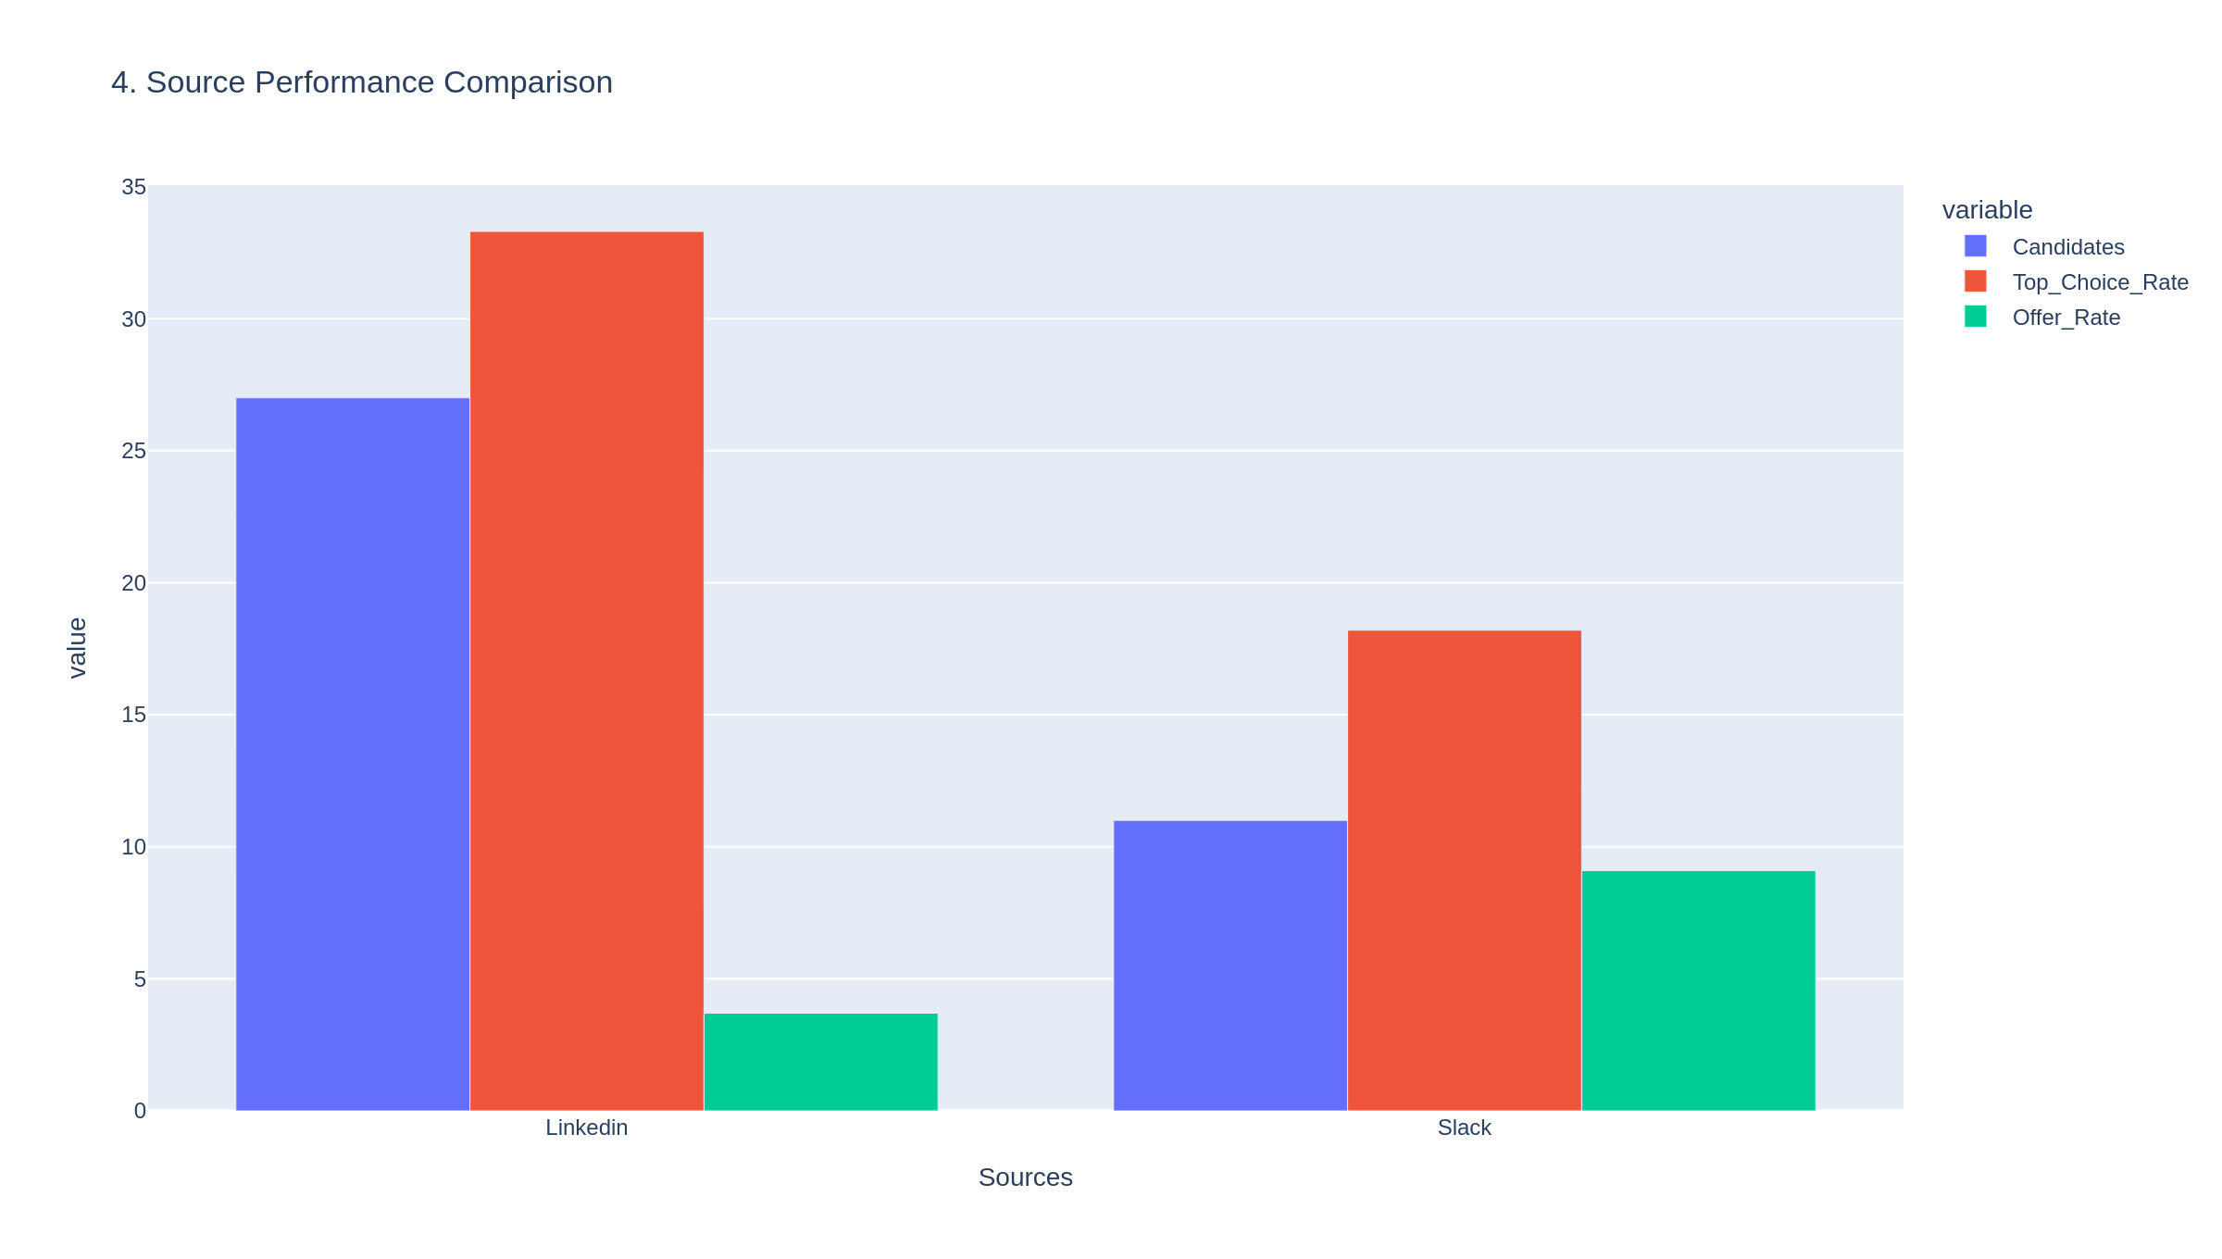
4. Source Performance

Slide 7
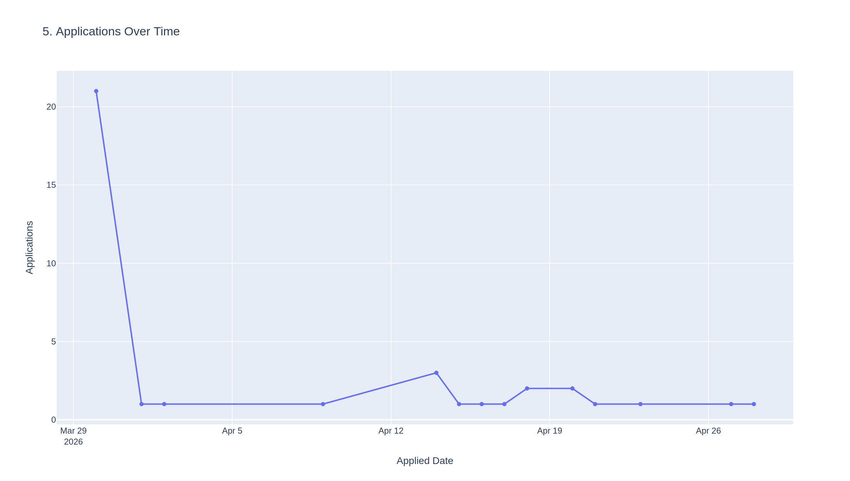
5. Applications Over Time

